Slide 1
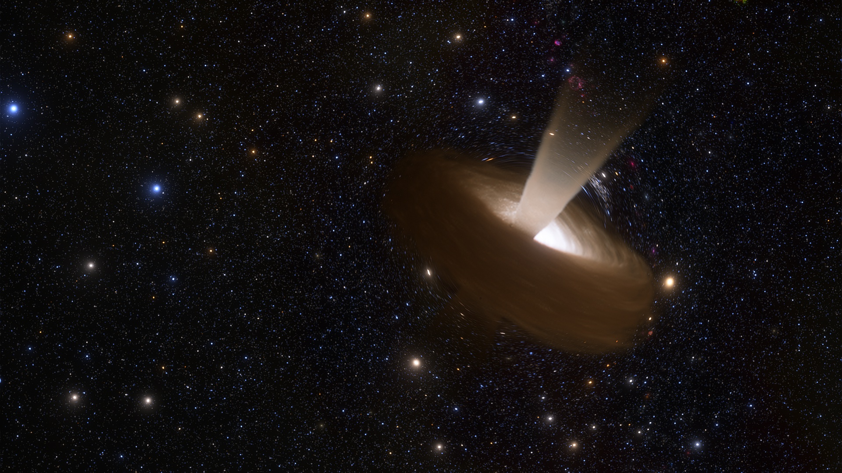
Binary Black Hole Mergers in AGN with N-Body Simulations
Ryan White and
Dr. Simon Stevenson
@astroryan.bsky.social
Image source: SpaceEngine

Slide 2
SMBH ‘Engine’
Accretion Disc
Image source: SpaceEngine

Slide 3
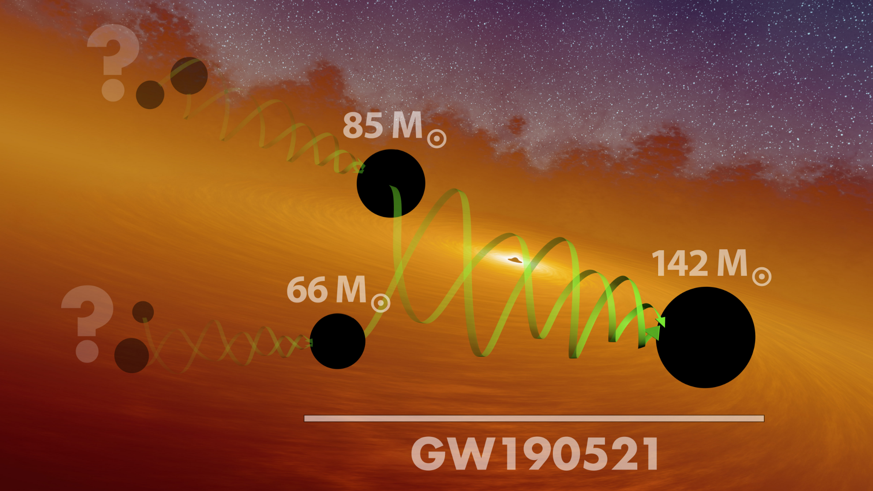
Why an AGN Channel?
Mergers have been detected with BH masses in the `mass gap’.
E.g. GW190521 with m₁≈85M☉ and m₂≈66M☉
These BHs could be 2nd/3rd generation?
AGN Disc models suggest that one or more `migration traps’ should be present
Image credit: LIGO/Caltech/MIT/R. Hurt

Slide 4
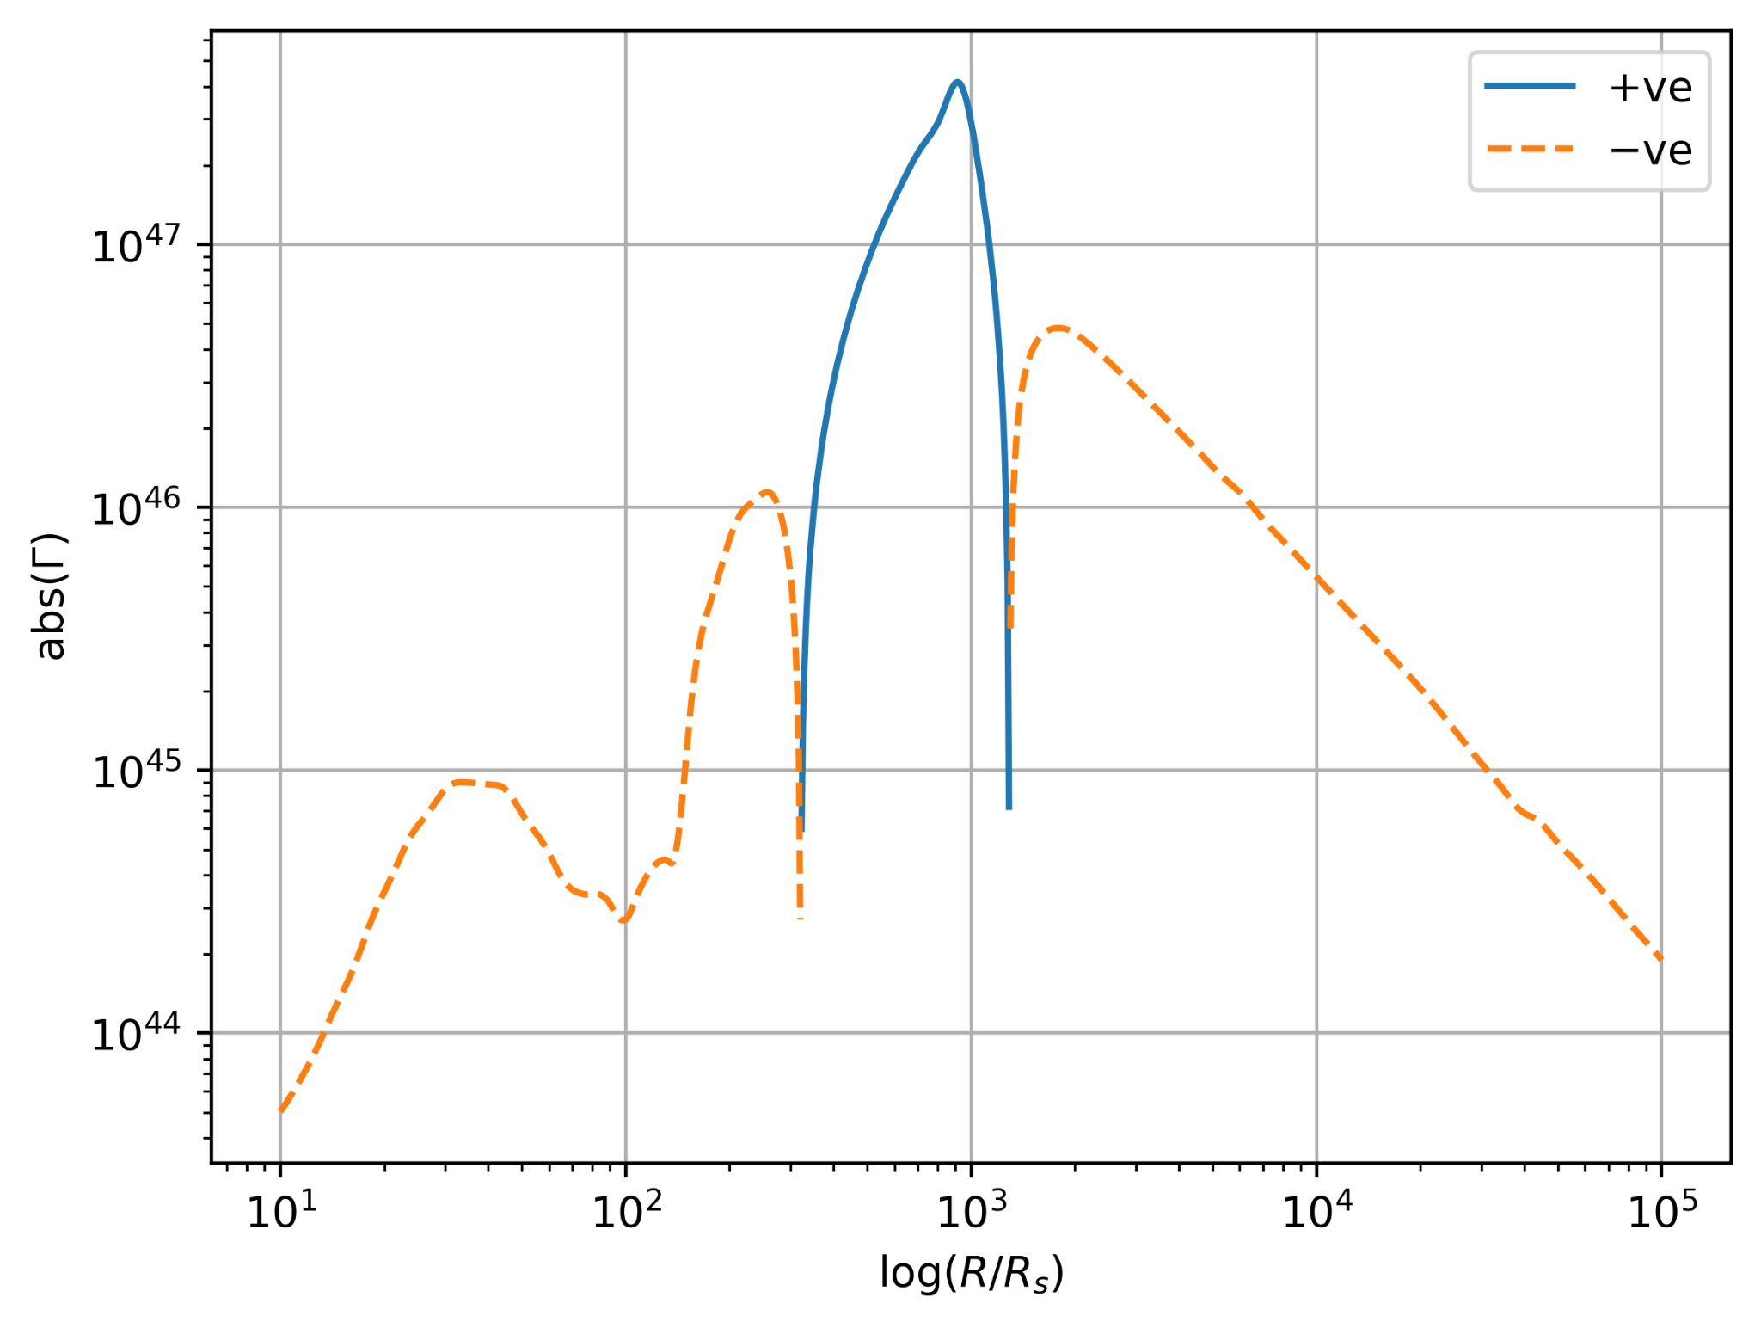
What is a migration trap?
Protoplanetary disc models are known to harbour migration traps
Using disc models available to us, we also expect migration traps in AGN discs
Could these migration traps produce hierarchical mergers?
Could this be our missing formation pathway to intermediate mass black holes?

Slide 5
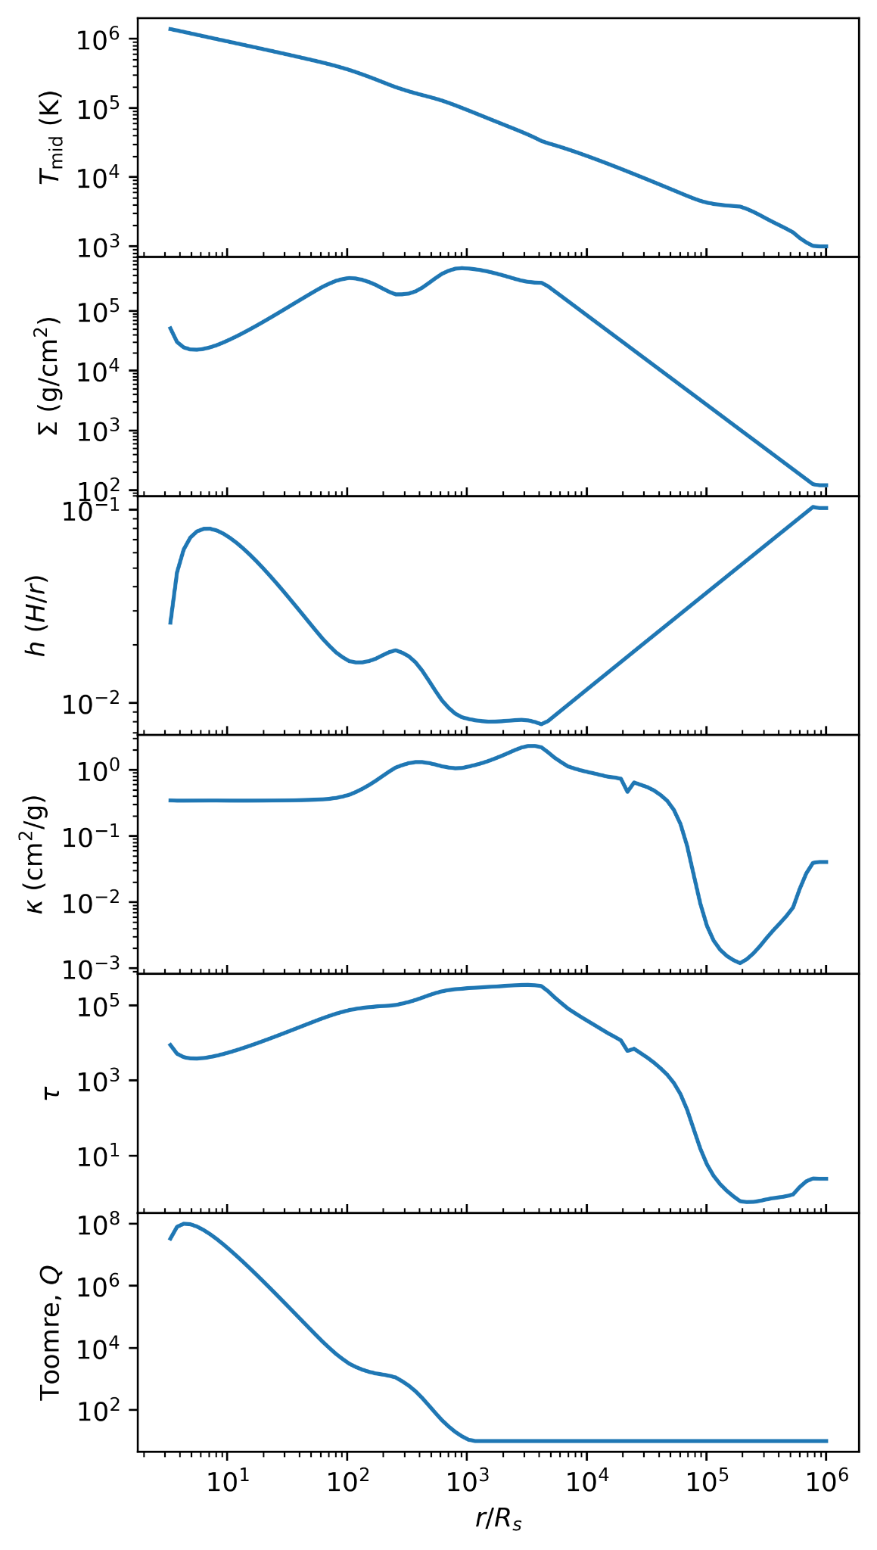
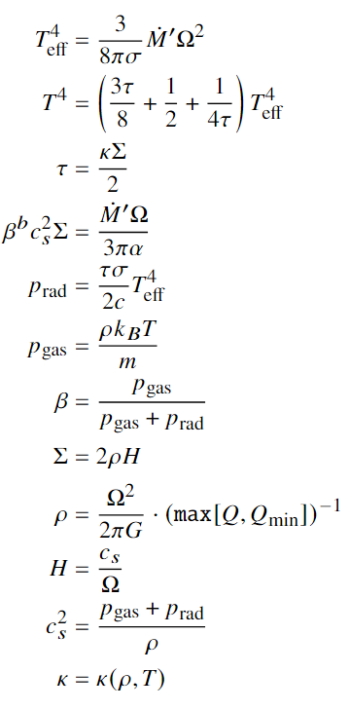
Creating an AGN Disc
Several semi-analytic disc models in the literature, but valid in different regimes
Thompson et al (2005) disc models seem to be better for the outer disc
Sirko & Goodman (2003) disc models seem to be better for the inner disc
Using either model, migration traps are expected in the inner(ish) regions of the disk
Need to numerically solve a system of equations (right) at each radius
Disc parameters are highly dependent on SMBH mass, accretion rate, and gas viscosity

Slide 6
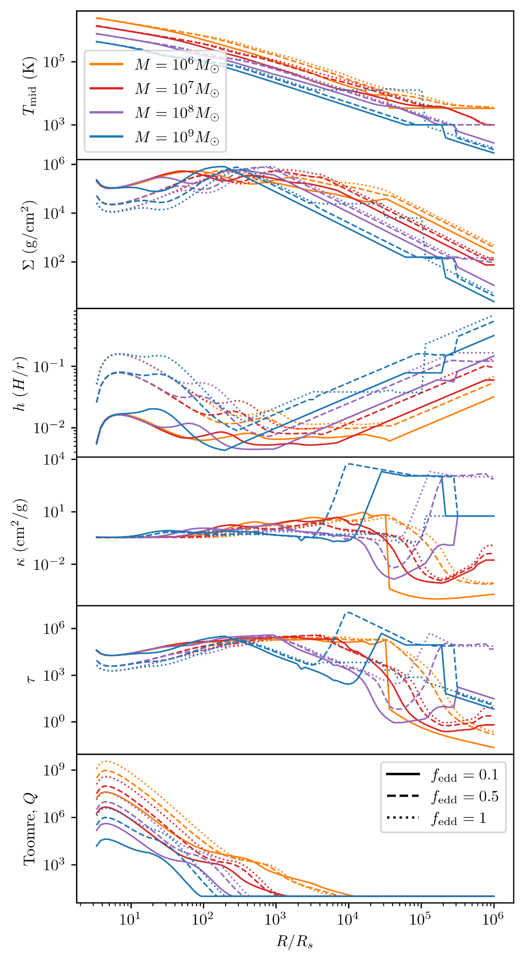
Creating an AGN Disc

Slide 7
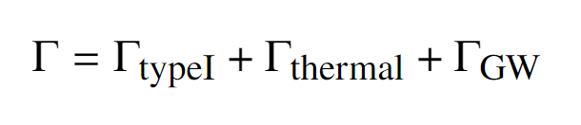
Where are the migration traps?
The magnitude and sign of disc forces (torques) are dependent on the disc and migration models we use
Start with a baseline of the GW inspiral torques of Peters (1964)
For the disc, I use the 3D Hydrodynamical simulation derived type I migration torques of Jiménez and Masset (2017)
Embedded BHs shouldn’t get massive enough to warrant type II migration
Also use the thermal torques from Grishin et al (2023)
Thermal torques arise from hot/cold under/overdensities of gas in the embedded BH-gas interaction

Slide 8
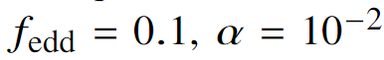
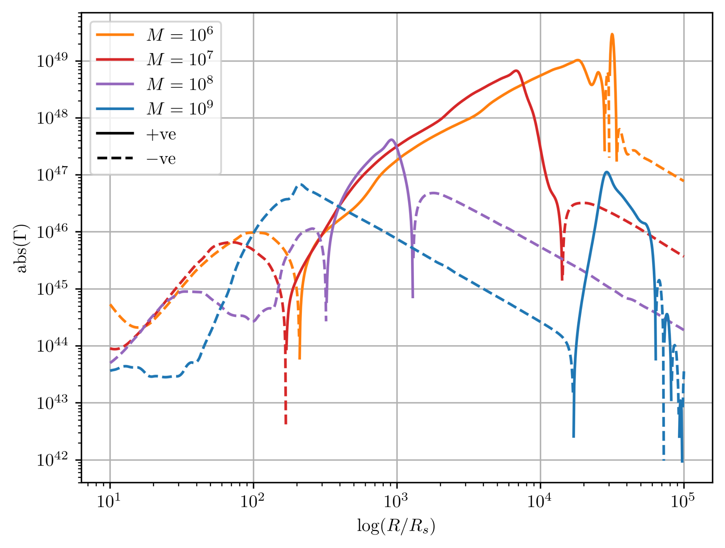
Where are the migration traps?

Slide 9
Where are the migration traps?
-ve
-ve
-ve
-ve

Slide 10
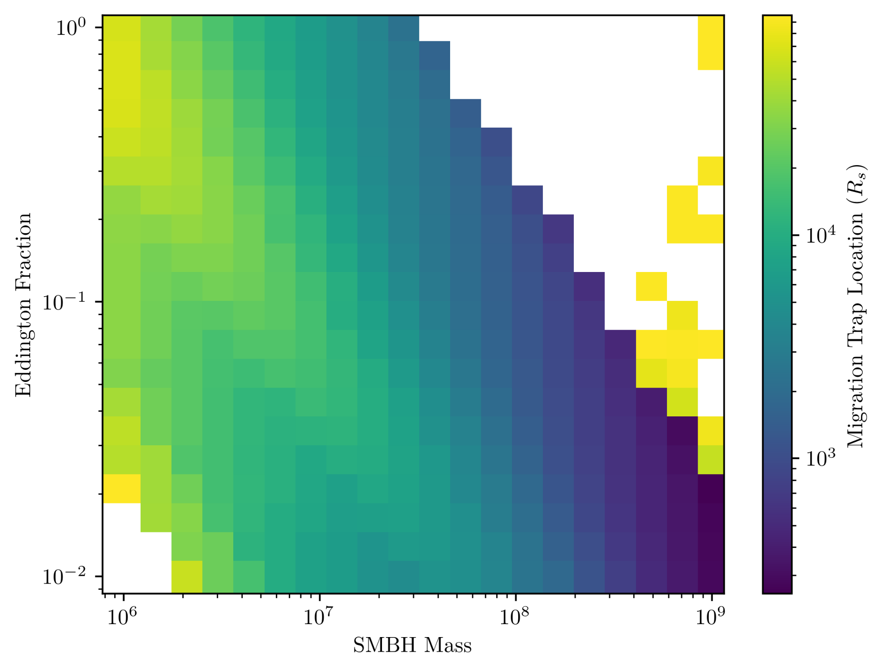
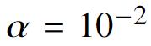
Where are the migration traps?

Slide 11
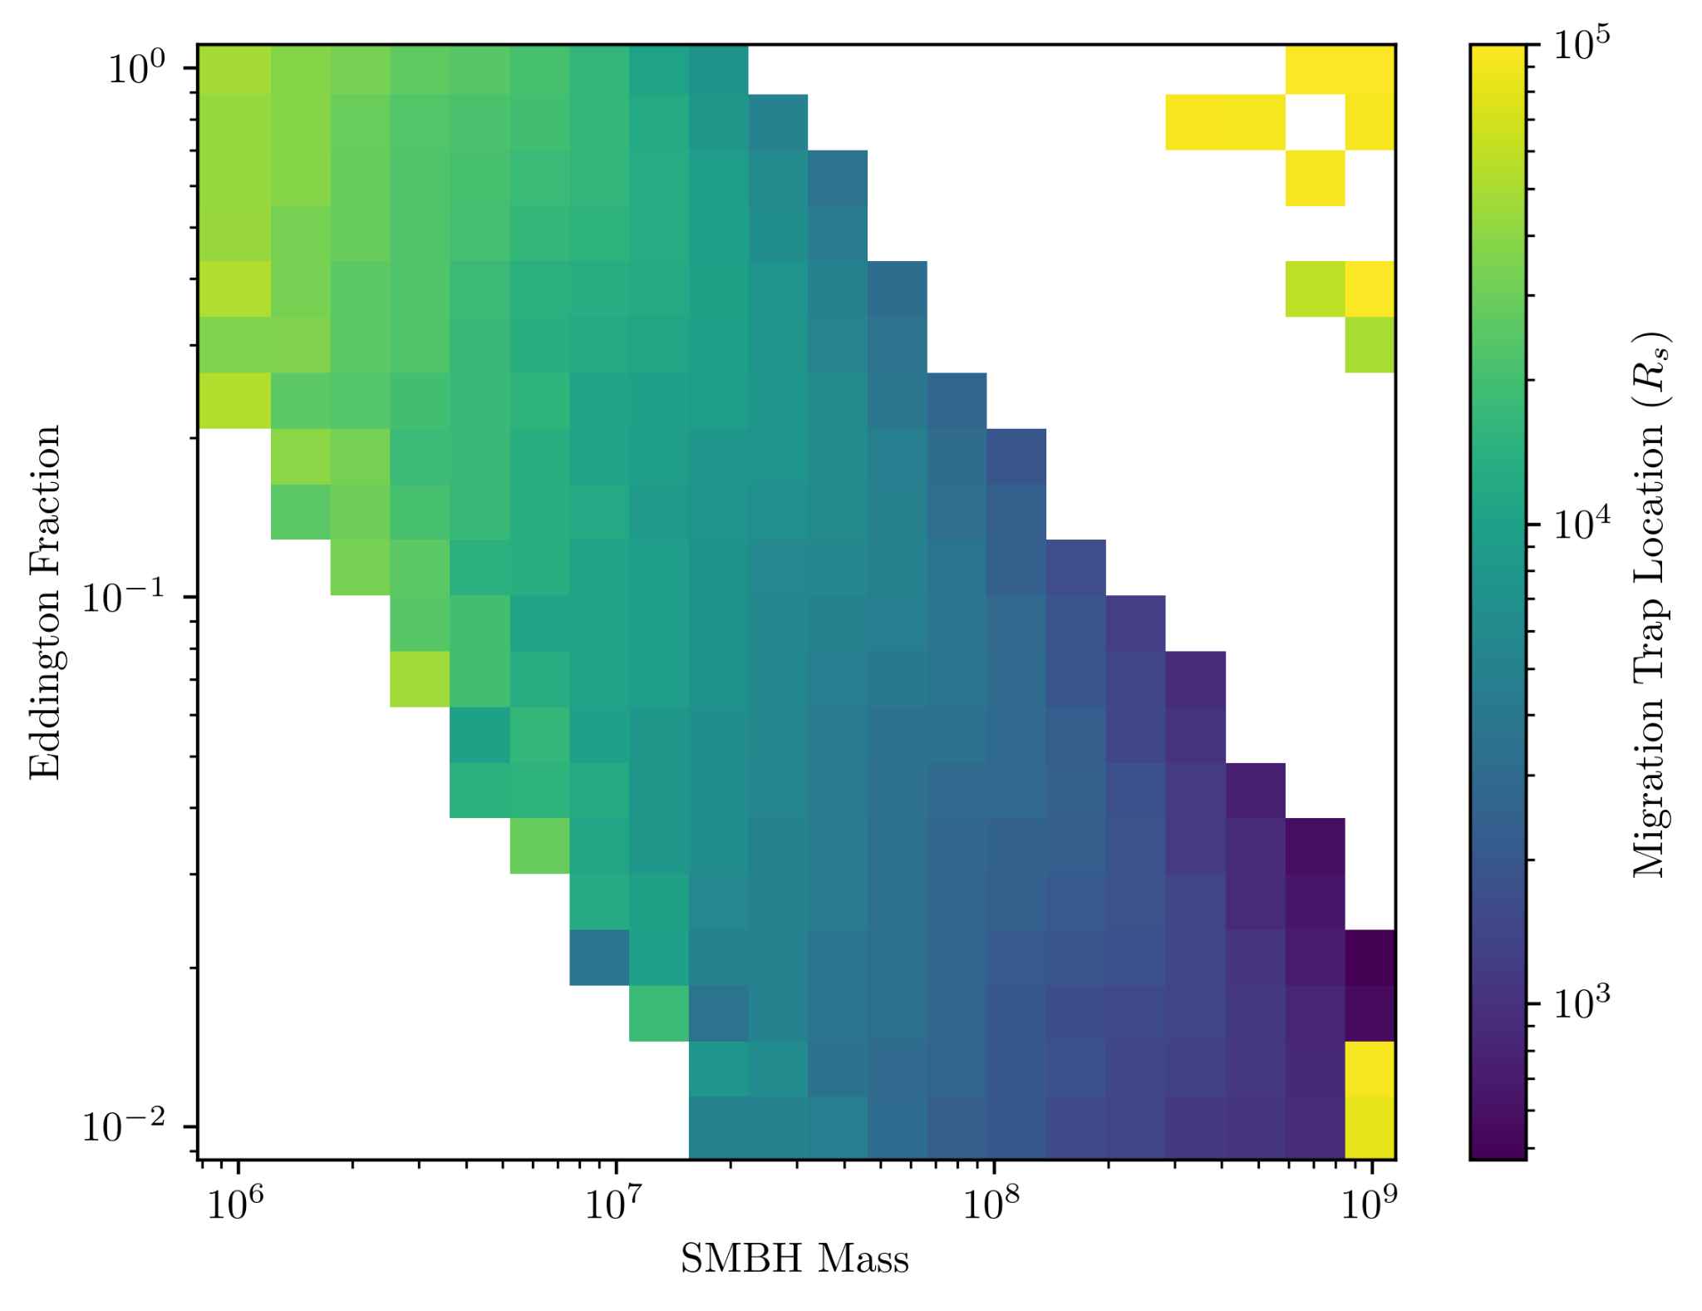
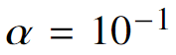
Where are the migration traps?

Slide 12

Time to simulate! - N-Body Code
Our simulations are done with REBOUND using an adaptive step size integrator
Tried making my own integrator to mixed results
REBOUND makes it easy to add additional forces (i.e. the disc torques)
But not for free! I had to learn C :(
Easy to check for/pseudo-simulate mergers
Easy to periodically (or randomly) add more BHs
Image credit: REBOUND/Hanno Rein

Slide 13
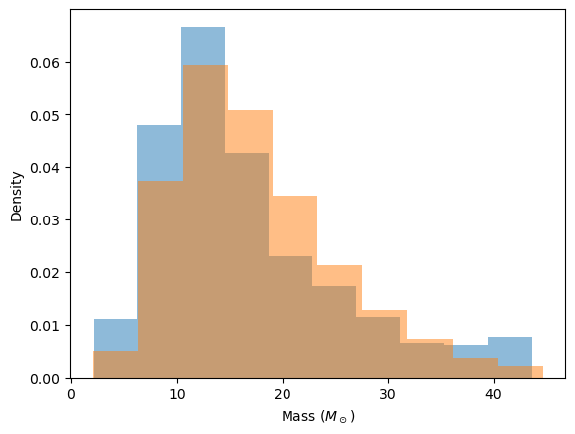
Time to simulate! - Initial Conditions
Several (~10) BHs start off on circular orbits of random semi-major axis slightly past the outermost migration trap
BH initial masses sampled from a fit-by-eye log-normal distribution to COMPAS output
Will probably make this more accurate!
All BHs have prograde orbits with respect to the AGN disc angular momentum
Tried simulating with retrograde orbiters
Omitted migration/thermal torques, replaced with gas dynamical friction
Impact on prograde orbiters was small/negligible!
More testing to be done…
COMPAS
Log-Normal Fit

Slide 14
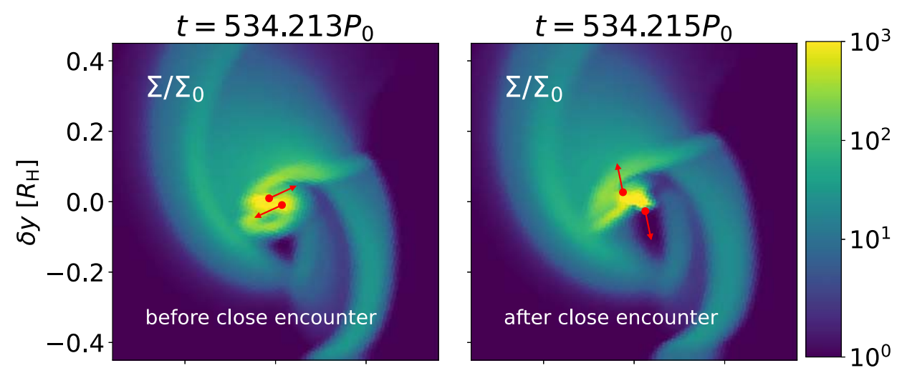
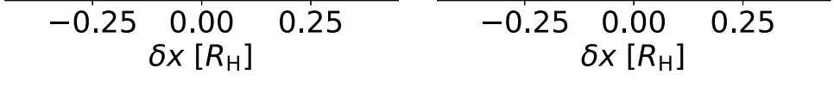
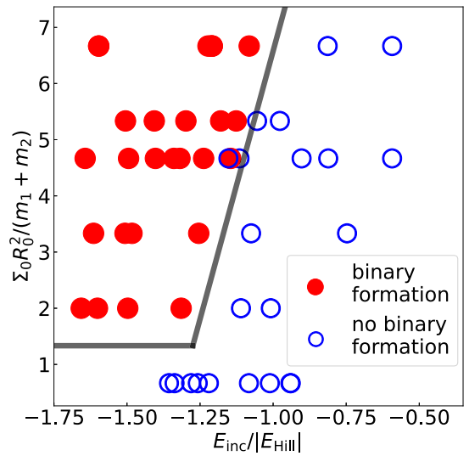
Time to simulate! - Mergers
We don’t simulate binary inspiral all the way down to merger
Computationally expensive
Not well understood in the AGN environment
We use the merger conditions of Li et al (2023) to predict when two BHs should form a binary with a merger end-condition
Calibrated with 2D hydrodynamical simulations
Relies on:
Local disk parameters
Binary masses and separation
Binary energy
Condition evaluated at 0.3 mutual hill radii
Our simulation isn’t 2D, but inclinations usually negligible
Image credit: Li et al (2023), ApJ

Slide 15
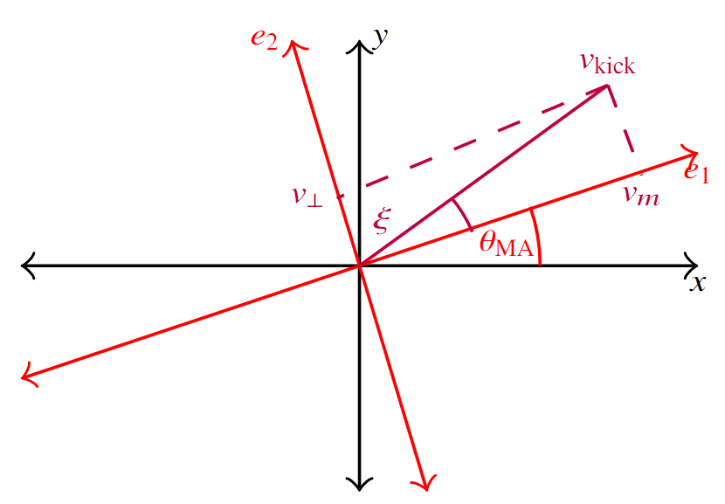
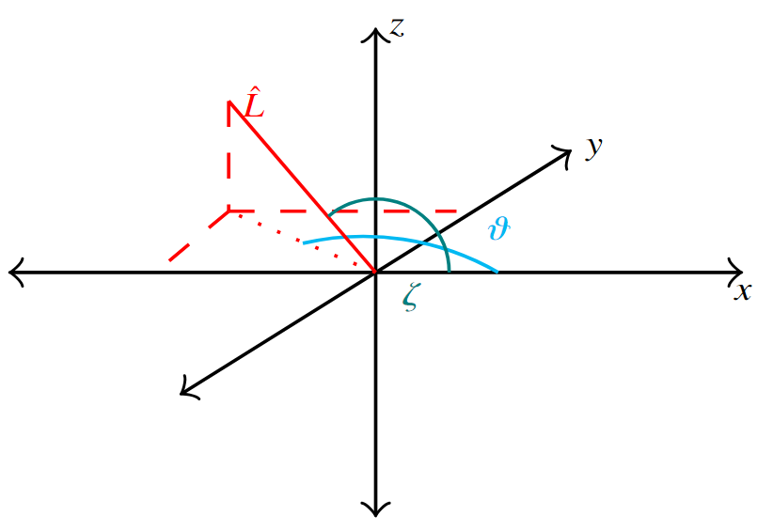
Time to simulate! - Mergers
We pseudo-simulate numerical relativity:
Merger remnant mass
Merger remnant final spin
Merger kicks:
Mass asymmetry
Spin alignment
Binary orbital inclination
Equations from Maggiore 2018
Need to rotate coordinate frame during merger, then de-rotate back to the original frame
REBOUND needed to be modified to contain the tri-axial spin parameters

Slide 16
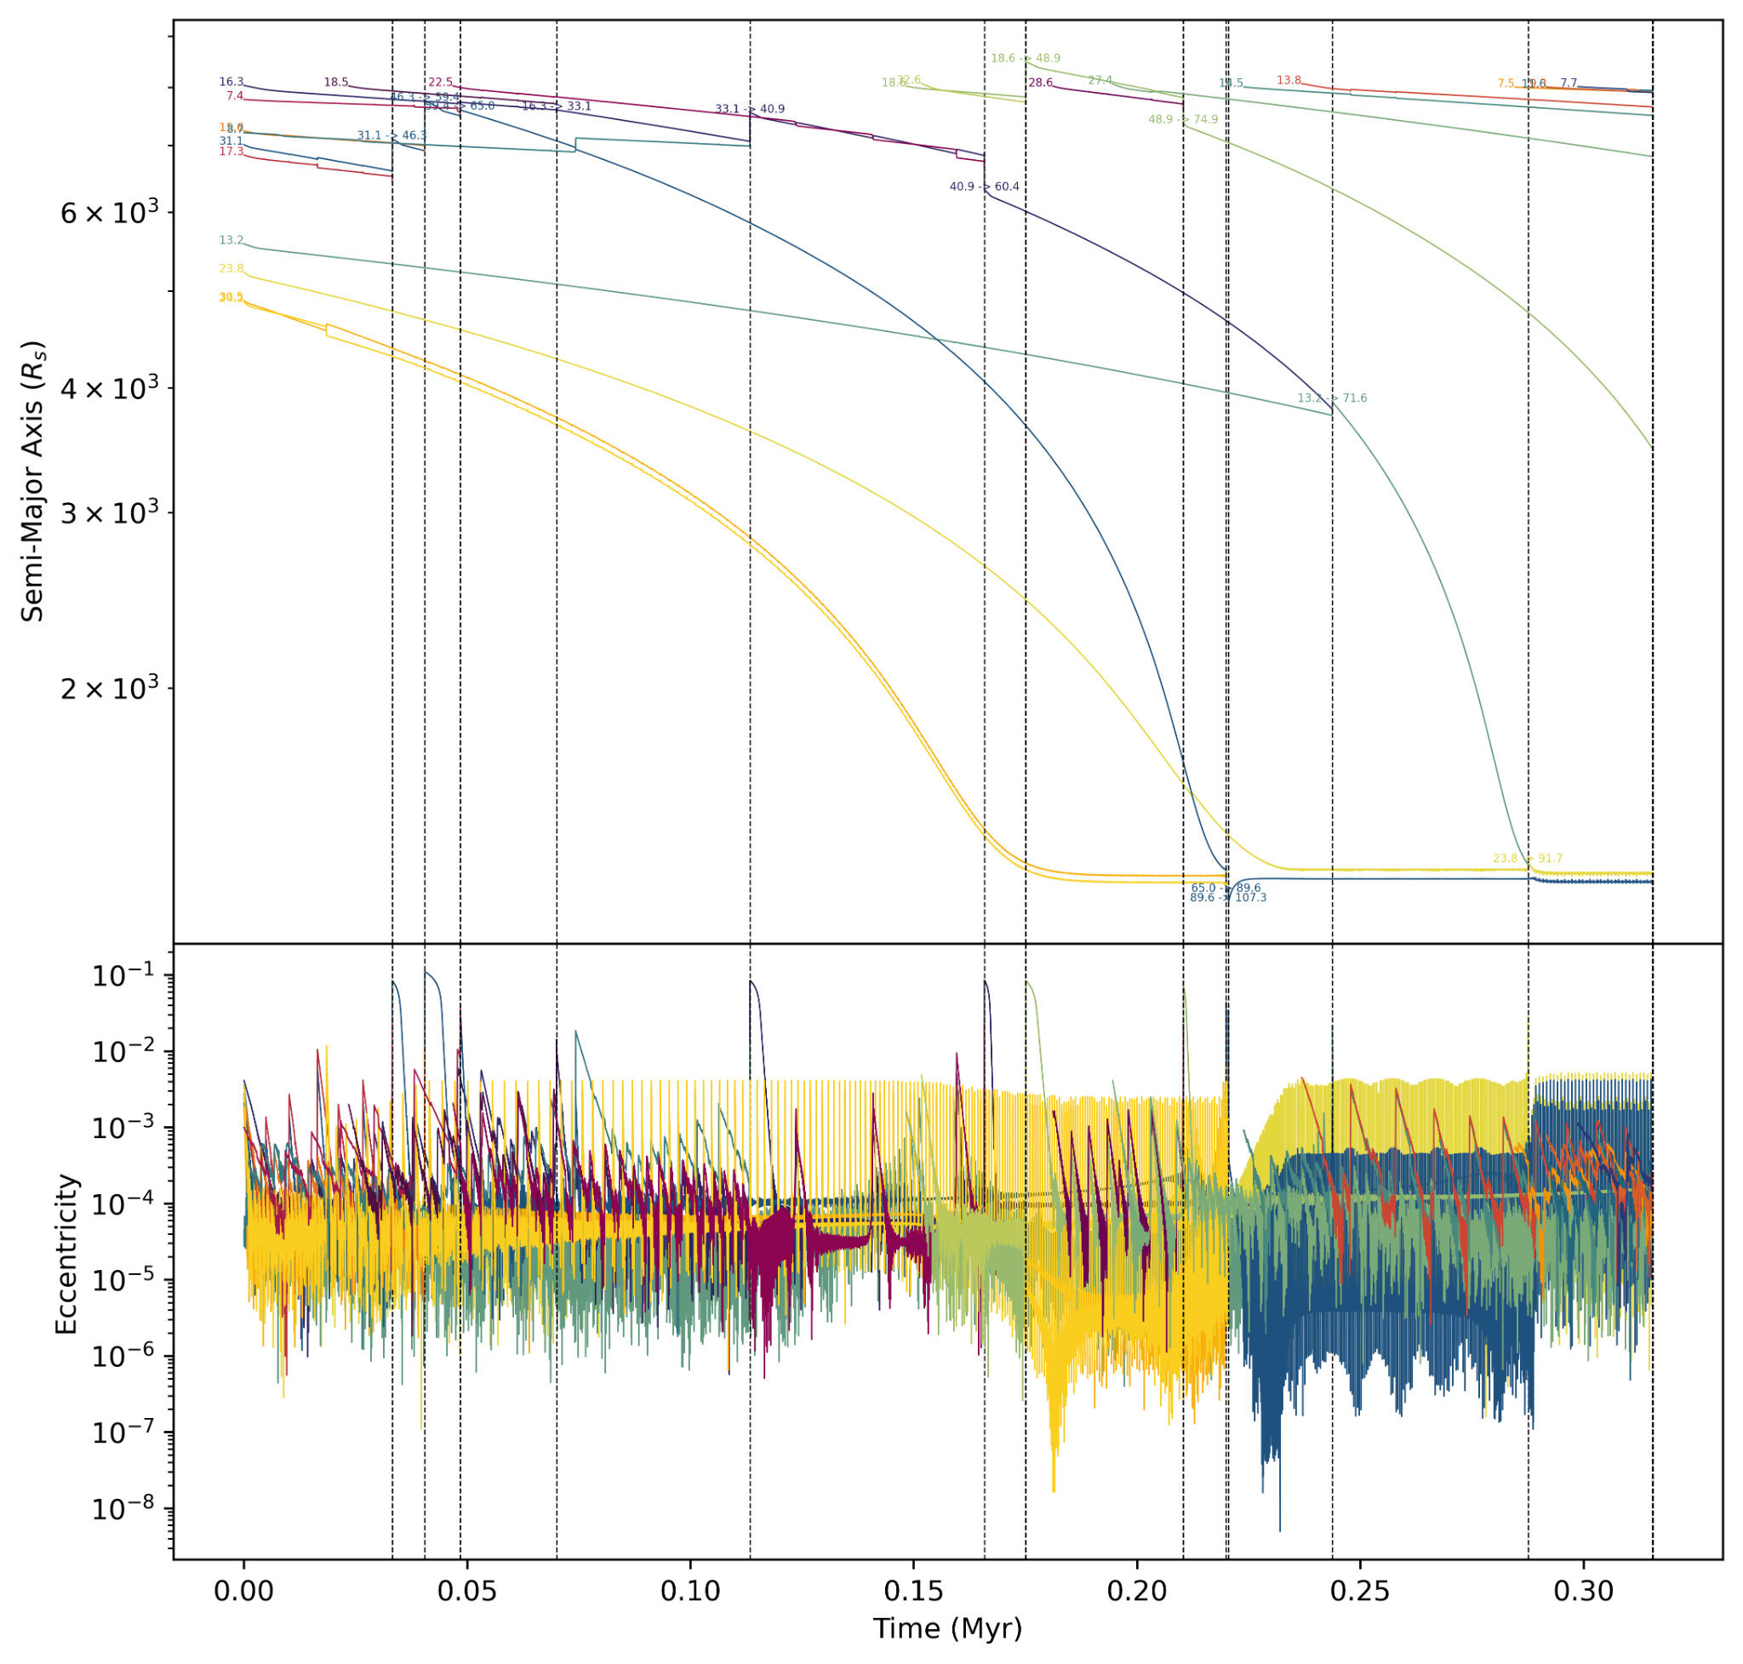
Results - 10⁸M☉ f_{edd}=0.1 𝛼=10⁻²

Slide 17
Results - 10⁸M☉ f_{edd}=0.1 𝛼=10⁻²

Slide 18
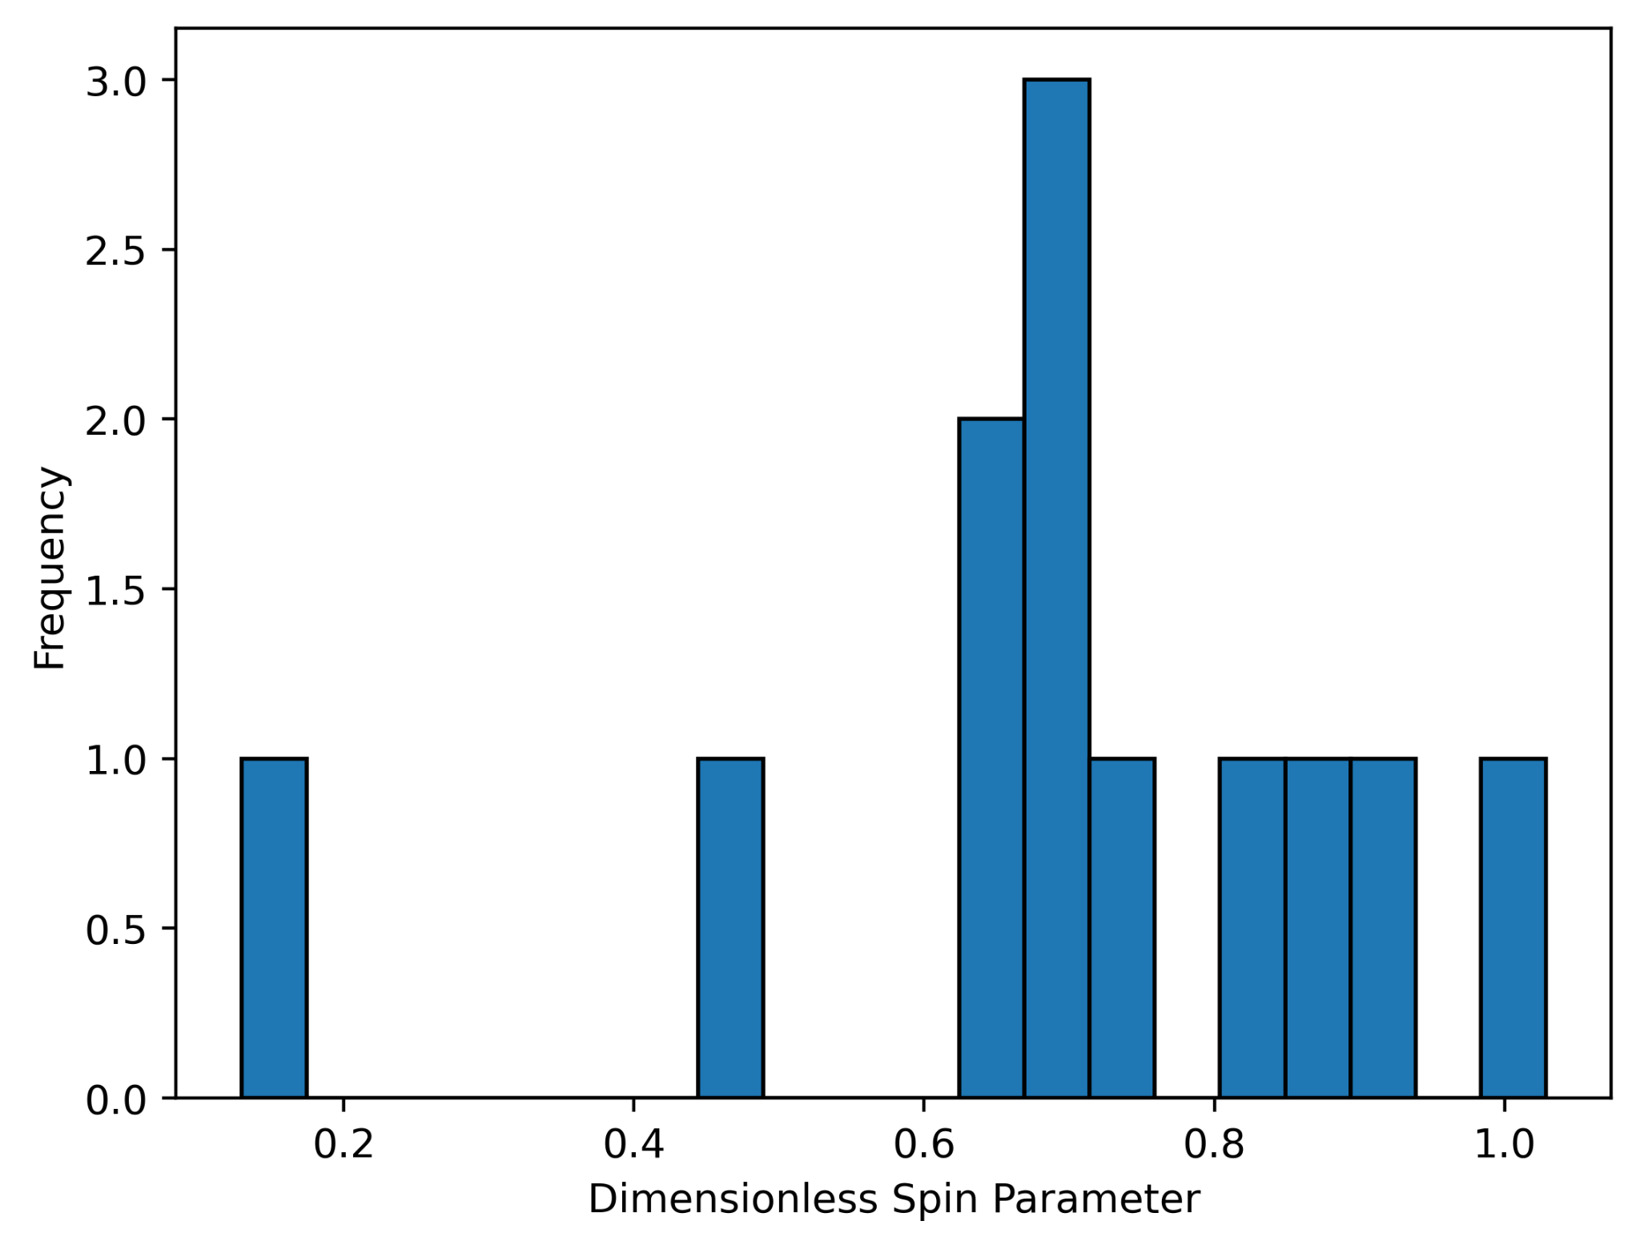
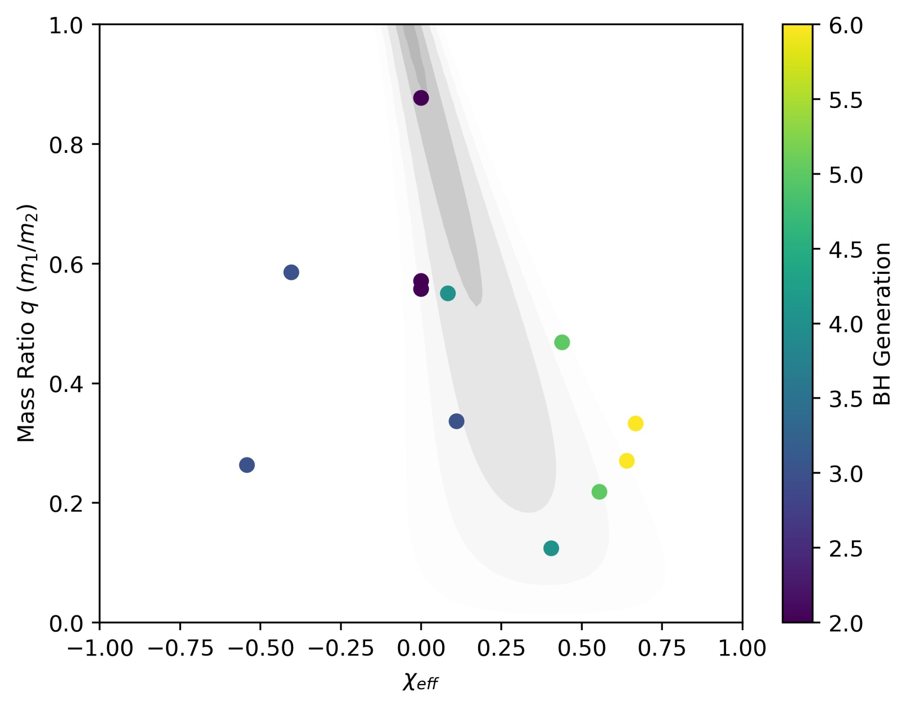
Results - 10⁸M☉ f_{edd}=0.1 𝛼=10⁻²

Slide 19
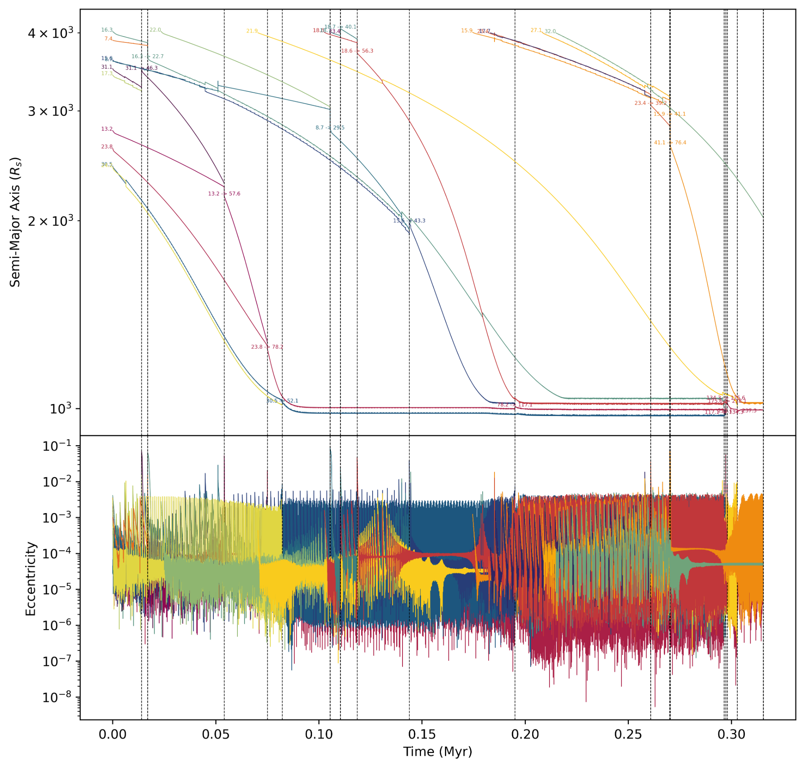
Results - 10⁸M☉ f_{edd}=0.25 𝛼=10⁻²

Slide 20
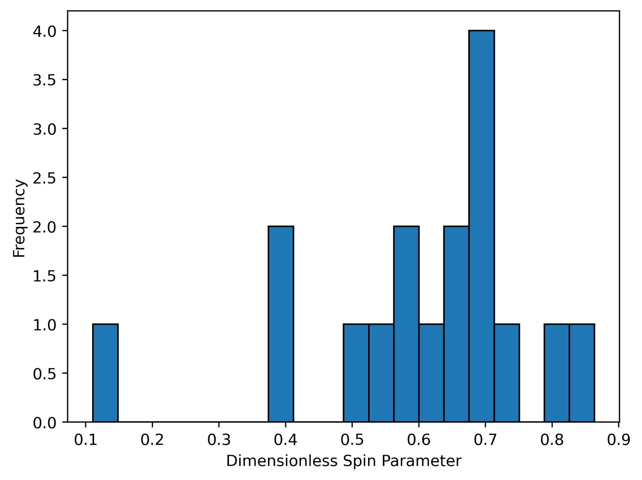
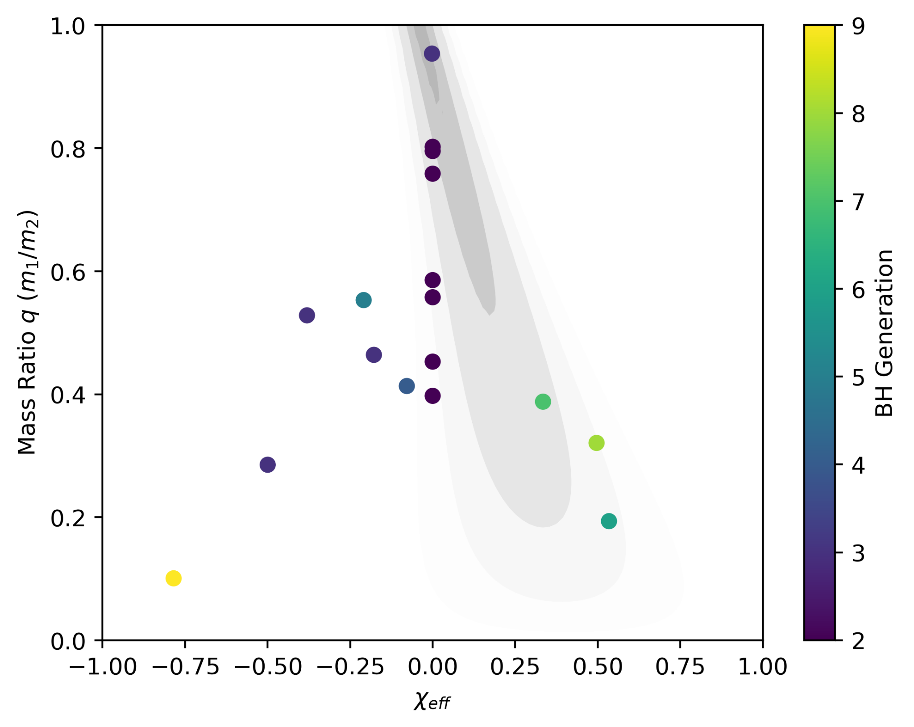
Results - 10⁸M☉ f_{edd}=0.25 𝛼=10⁻²

Slide 21
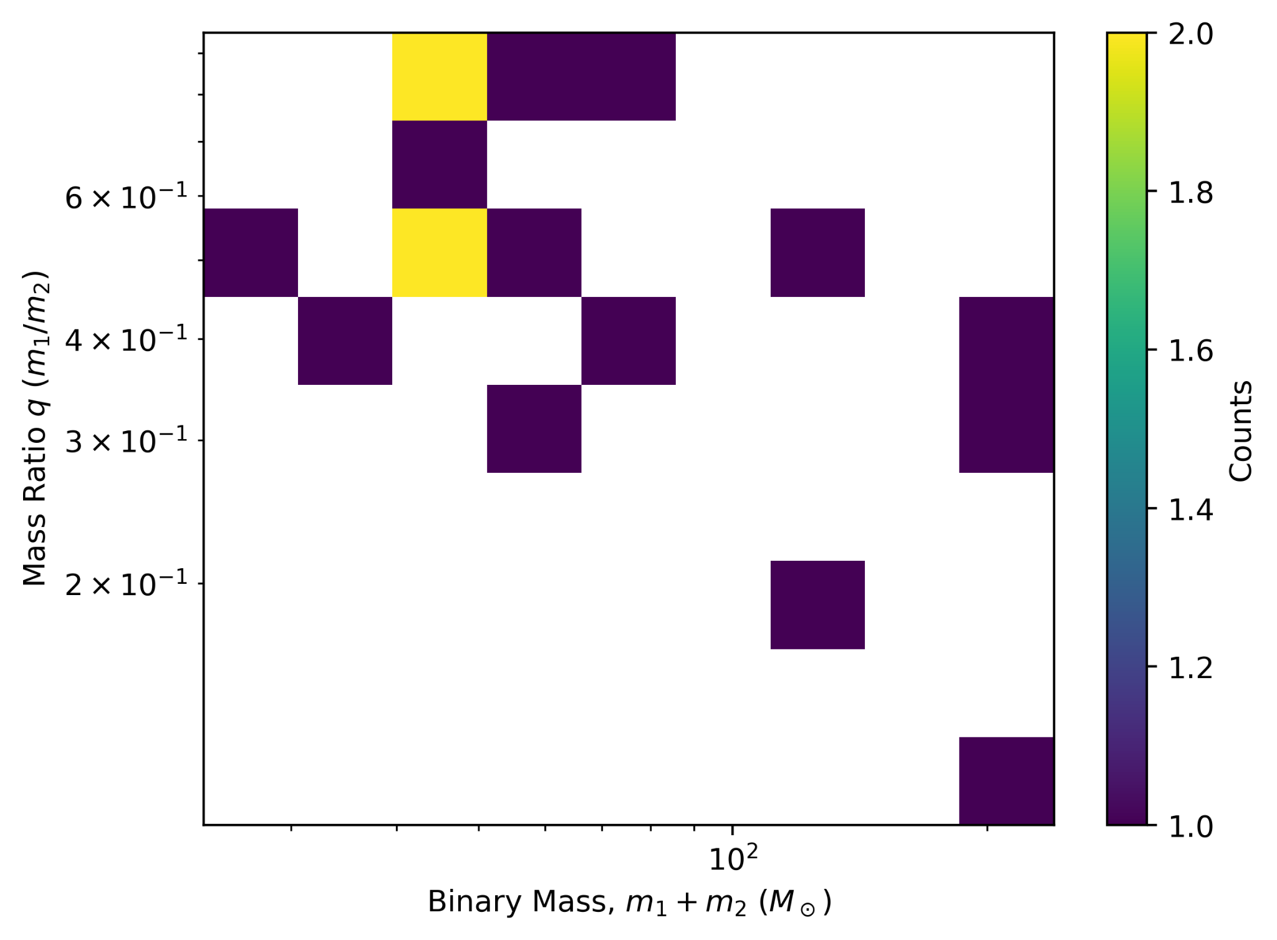
Results - 10⁸M☉ f_{edd}=0.25 𝛼=10⁻²

Slide 22
Results - 10⁸M☉ f_{edd}=0.25 𝛼=10⁻²
GW190521

Slide 23

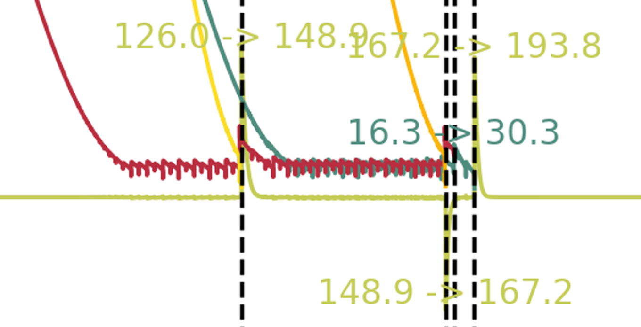
Results
16.3
15.6

Slide 24
To-do…
Still need to simulate over most of the accretion/mass/viscosity parameter space
Aim to collate merger rate and remnant spin results across simulations
Volume rate estimate for the AGN channel overall
More accurately initialise/add black holes to the simulation during runtime
Animate more black hole interactions
Still drafting the paper, fixing bugs in the code as I spot them

Slide 25
Thank you for listening!
References:
Grishin E., Gilbaum S., Stone N. C., 2023, arXiv e-prints, p. arXiv:2307.07546
Jiménez M. A., Masset F. S., 2017, MNRAS, 471, 4917
Li J., Dempsey A. M., Li H., Lai D., Li S., 2023, ApJ, 944, L42
Maggiore M., 2018, Gravitational Waves: Volume 2: Astrophysics and Cosmology. Oxford University Press, doi:10.1093/oso/9780198570899.001.0001
Sirko E., Goodman J., 2003, MNRAS, 341, 501

